Slide 1
Good
morning

Slide 2
Introduction
Class: One
Subject: English
Alphabet. Lesson:4-6,
Unite : 1. Page : 3
Farjana Amin
Assistant teacher
Dhadas Govt. Pri. School
Puthia, Rajshahi.

Slide 3
Lets see the video

Slide 4
Lesson Declaration
C
c
Alphabet(Cc)

Slide 5
Learning outcome
Students will be able to-
1.1.1 to become familiar with English sounds by listen to
common English word.
1.1.2 to say simple words.
1.2.1 to recognize and read the alphabet both small and
capital (non-cursive) letters.
3.1.2 write words using non-cursive small letters.

Slide 6
Look, listen and say
C
c
cap

Slide 7
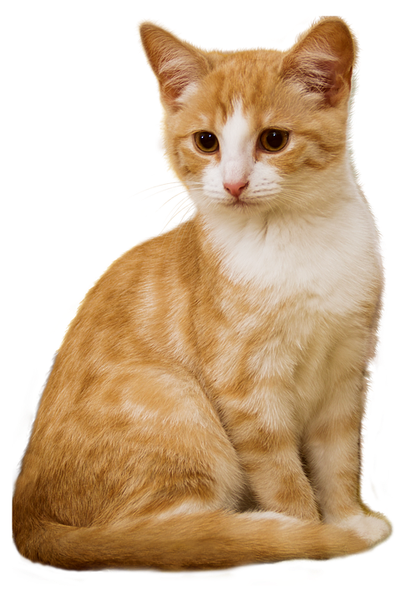
Look, listen and say
C
c
Cat

Slide 8
Look, listen and say
C
Cap
Capital letter

Slide 9
c
Cat
Small letter

Slide 10
Look, listen and say. Trace in the air.
C
C

Slide 11
Look, listen and say. Trace in the air.
C
C
C

Slide 12
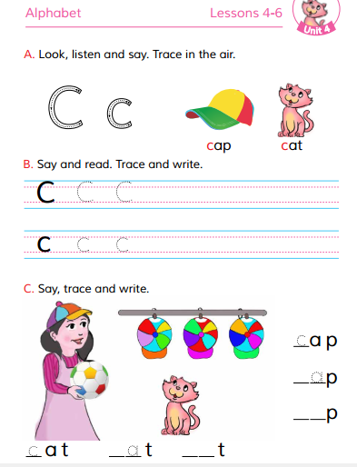
Open at page 5

Slide 13
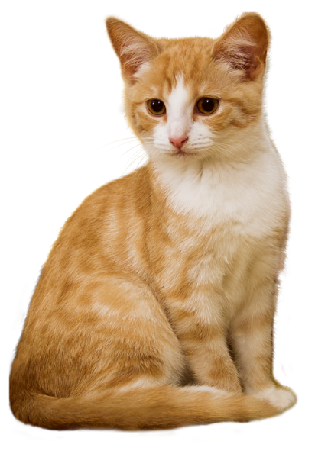
WCW
Loud reading by the teacher
Cat
Cap

Slide 14
Group work
Match the pictures with the letters:
C
Cat
C
Cap

Slide 15
Say and read. Trace and write.
WCW
C
C
C
c
c
c

Slide 16
Look and say. Write.
Evaluation
Look at the picture and fill in the gaps:

Slide 17
Evaluation

Slide 18
Good bye

